Slide 1

Epidemiological situation of African swine fever in Asia
Anne Conan
Research Associate Professor
City University of Hong Kong

Slide 2
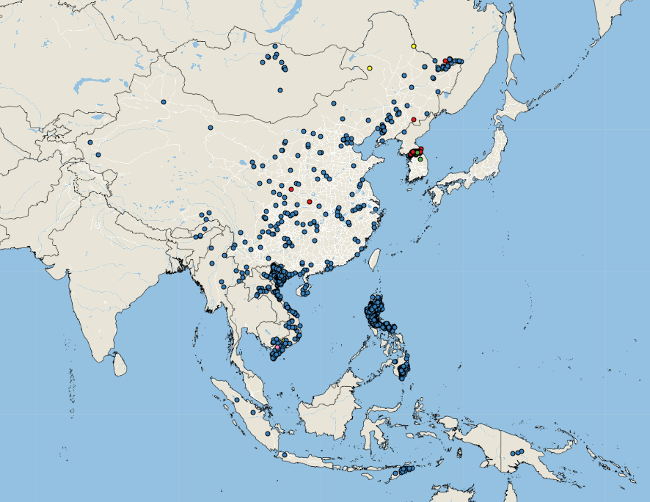
ASF outbreaks reported in 2018-2020
FAO empress

Slide 3
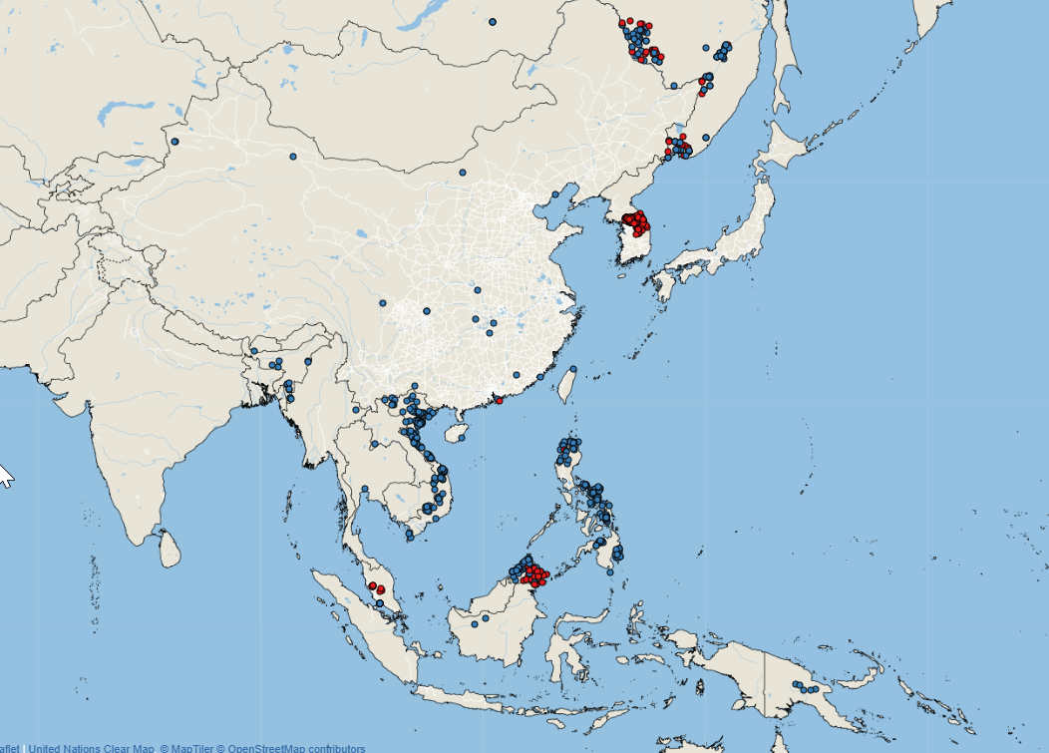
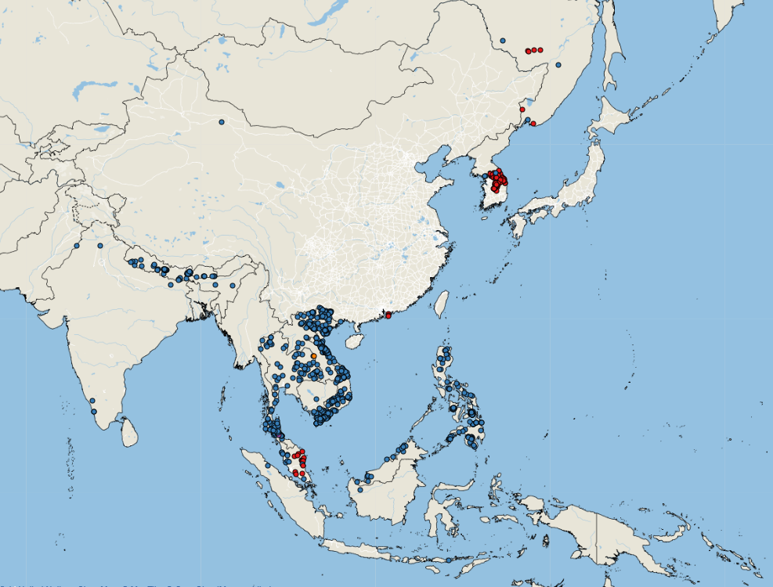
ASF outbreaks reported in 2021 and 2022
FAO empress
FAO empress

Slide 4
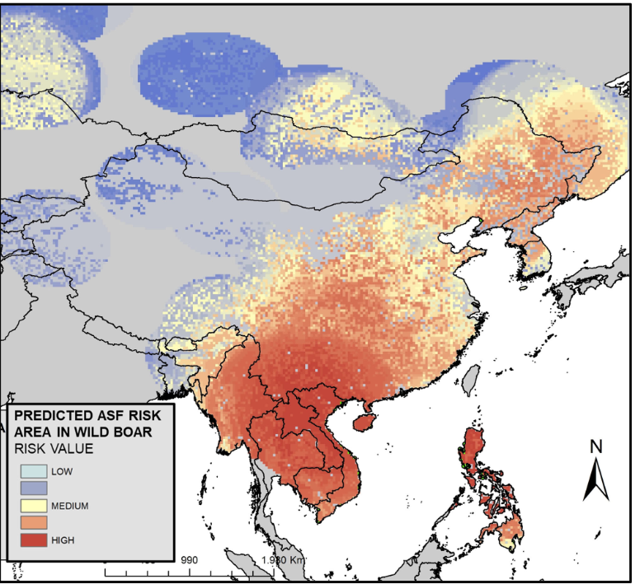
Wildlife interface
Role in Asian cycle(s) unknown
Risk for endangered species
Cadenas-Fernandez et al. Frontiers in Veterinary Sciences (2022)
Notes:
Data collected until January 2021

Slide 5
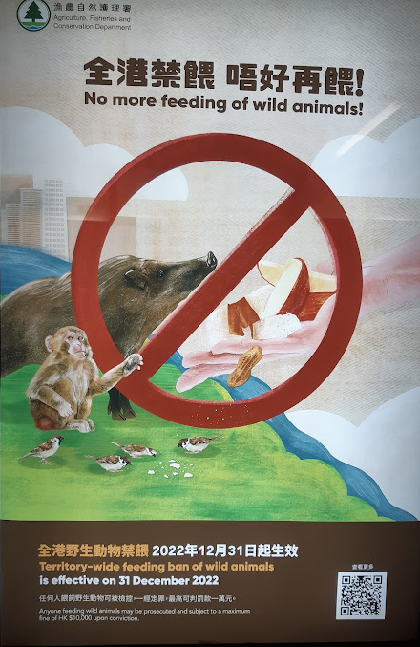
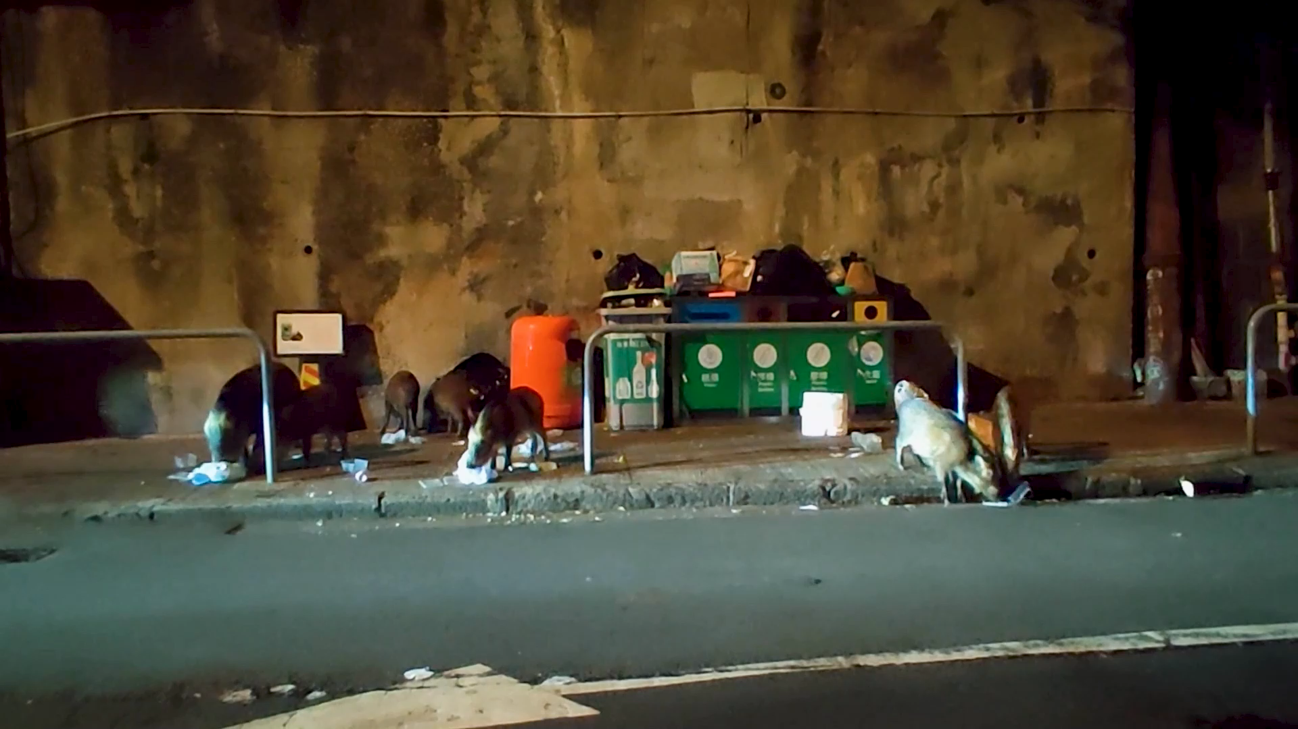
Wildlife interface
Role in Asian cycle(s) unknown
Risk for endangered species
Interface human-wildlife
Cadenas-Fernandez et al. Frontiers in Veterinary Sciences (2022)
Notes:
Data collected until January 2021

Slide 6
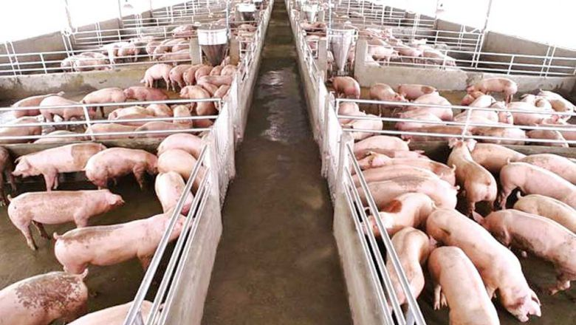
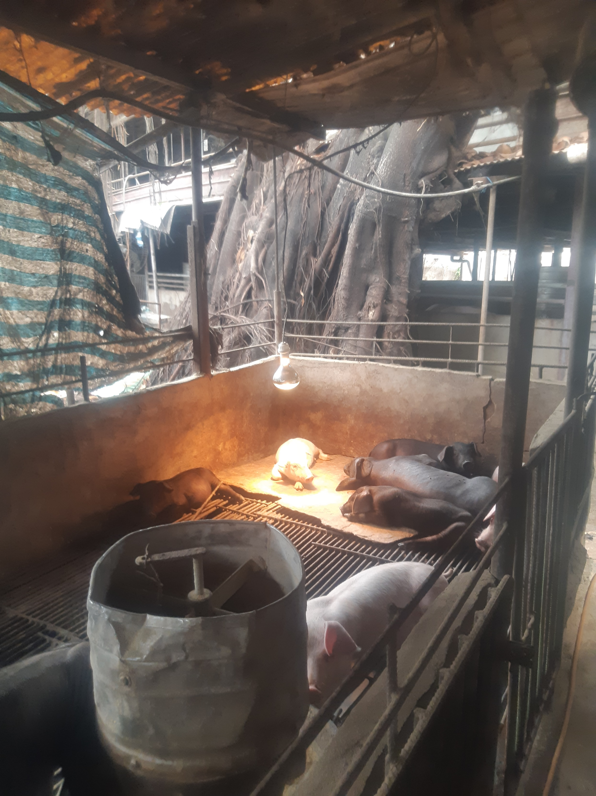
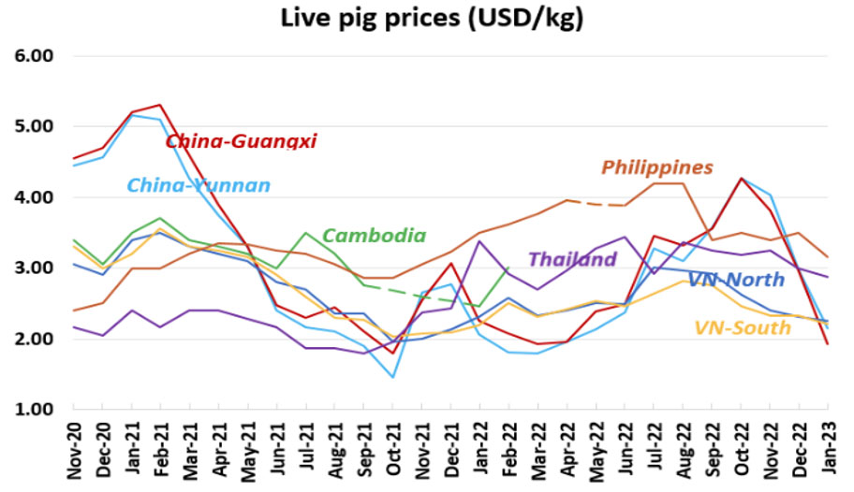
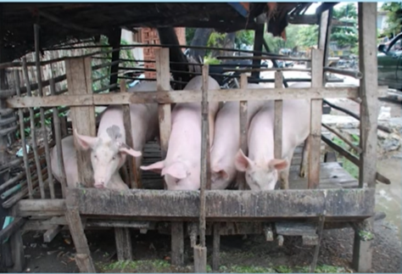
Domestic pig production in Asia
Variety of systems and variety of value chains
Phnom Penh post
FAO: African swine fever (ASF) situation update in Asia & Pacific (Jan 2023)
Credit: Dr. Tu Tu Win
Notes:
https://www.phnompenhpost.com/business/farmers-remain-sceptical-even-local-prices-pigs-double

Slide 7
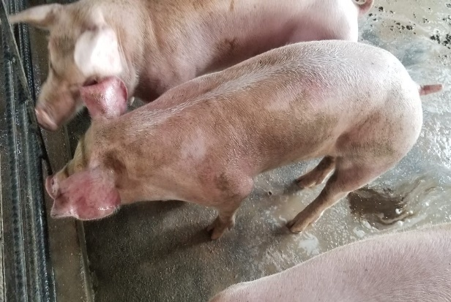
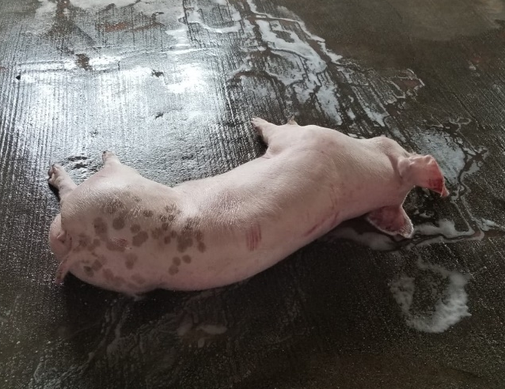
First case in domestic pigs in Hong Kong (2021)
29 Jan, 2021
Disease notification by the farmer to CityU Veterinary Service
Post-mortem examination of a dead finisher by CityU VDL
24 Jan, 2021
Clinical signs observed and biosecurity measures strengthened at farm by the farmer
2 Feb, 2021
Tissue samples from index pig tested ASF positive by AFCD
Outbreak investigation: Six of 30 pigs tested ASF positive by AFCD
16 Feb, 2021
Culling of pigs in the farm completed by AFCD
17
18
19
20
21
22
23
24
25
26
27
28
29
30
31
1
2
3
4
5
6
7
8
9
10
11
12
13
14
15
16
February 2021
Introduction of ASFV?
5
From Go et al. (under review): Investigation of the First African Swine Fever Outbreak in a Domestic Pig Farm in Hong Kong

Slide 8
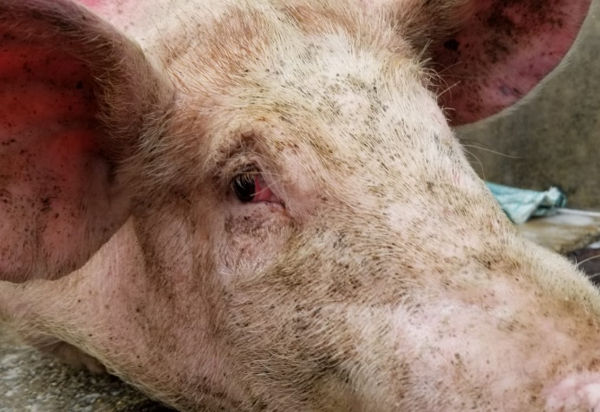
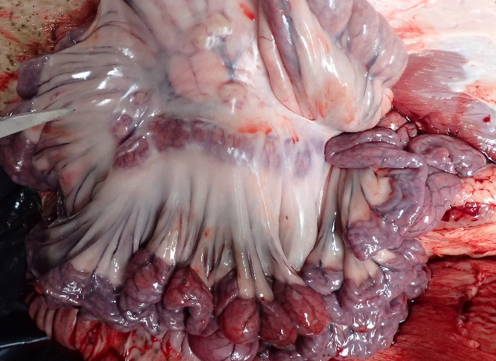
Outbreak investigation
Before visit of the veterinarian (over 5 days)
  Morbidity (clinical): 63 % (24/38)
  Mortality: 11 % (4/38)
First signs: non specific (inappetence)
Fever, red and purple discoloration of extremities, respiratory symptoms
Genotype II, IGR (I73R-I329L) II variant, CVR-1, MGF-1 (IGR of MGF505 9R/10R), and serogroup 8
From Go et al. (under review): Investigation of the First African Swine Fever Outbreak in a Domestic Pig Farm in Hong Kong
Notes:
In 2018, the average pig mortality during the finishing phase was 2.9% and 4.5% in the European Union and in the USA, respectively.
In the European Union in 2018, pigs spent an average of 111 days in the finishing section, resulting in a daily average pig mortality of 0.03% for the EU.
ASF surveillance programme for dead wild boars has been in place since Nov 1, 2019. Thirty-six wild boar carcasses in HK SAR were tested negative for ASFV under such programme as of Jan 31, 2021
Genotype II, IGR (I73R-I329L) II variant, CVR-1, MGF-1 (IGR of MGF505 9R/10R), and serogroup 8

Slide 9
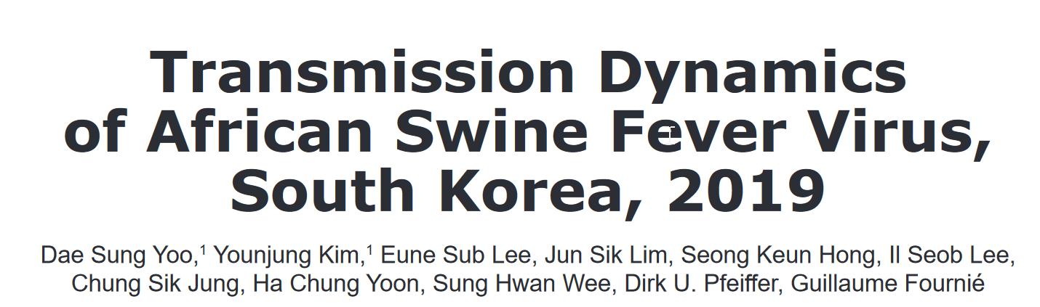
Hypotheses of the source
Pathways
Findings
Wildboar
Surveillance dead boar (up to outbreak): Negative
Feed
No ASFV in feed product
Live pig
Last introduction of pigs: 2019 (from
Taiwan)
Live on the farm
Fomites: Workers
and family
Environment ASFV negative
Dad visited >1y ago
Entrance: high pressure water hose with disinfectant
Fomites: Vehicle
Food: No other cases in HK
Pig to abattoir: ASFV detected 3 times from 2019 to 2021
From Go et al. (under review): Investigation of the First African Swine Fever Outbreak in a Domestic Pig Farm in Hong Kong

Slide 10
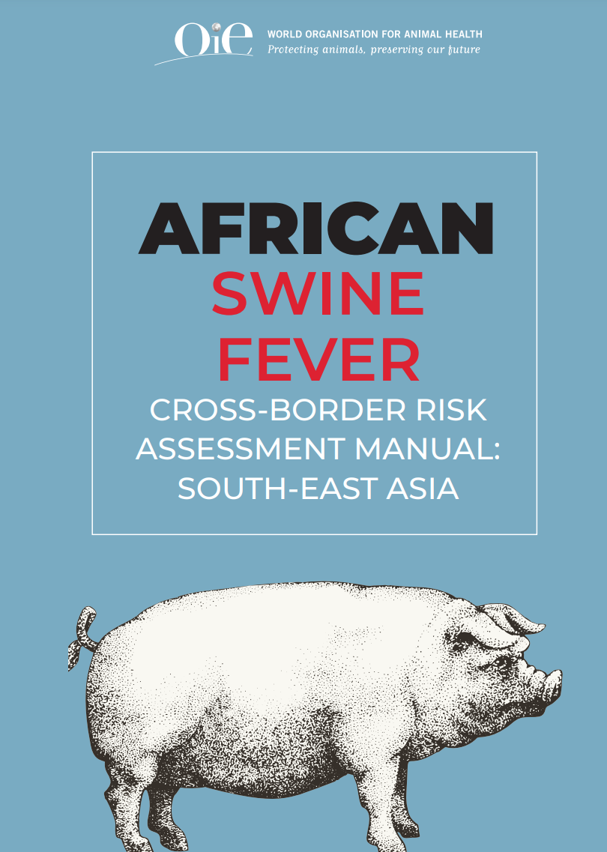
Cross-border risk assessment training (2021)
Risk pathways | No countries considering the RP (N=10)
P1. Trade of live domestic pigs | 9
P2. Trade of semen & genetic materials of domestic pigs | 5
P3. Trade of domestic pig products | 10
P4. Fomites associated with domestic pig farming | 5
P5. Non-commercial domestic pig movements | 3
P6. Trade of contaminated feed & infected ingredients | 6
P7. Trade of live wild boars | 0
P8. Trade of semen & genetic materials of wild boars | 0
P9. Trade of wild boar products | 1
P10. Fomites associated with wild boars | 1
P11. Non-commercial wild boar movements | 1
P12 Cross border movement of wild boars | 8
P13 Hunters crossing borders | 3
P14 Trade of wild meat | 4
P1. Trade of live domestic pigs
9
P3. Trade of domestic pig products
10
P4. Fomites associated with domestic pig farming
5
P6. Trade of contaminated feed & infected ingredients
6
P12 Cross border movement of wild boars
8
Conan et al. 2021. African Swine Fever Cross-border Risk Assessment: South-East Asia. Scientific Report. World Organisation for Animal Health(OIE) Sub-Regional Representation for South-East Asia, Bangkok, Thailand, 121 pp.

Slide 11
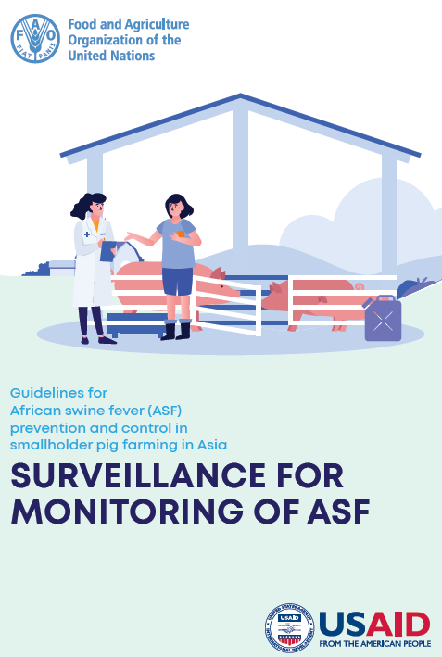
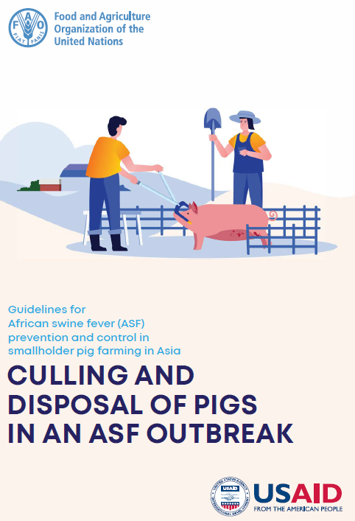
Surveillance, prevention and control
Changing clinical presentation,
  Emergence of low virulence strains and/or spread of vaccine strains?
  Case definitions to review?
Endemicity or elimination
  Country level: issue with wildboar
    Population control
    Fencing
    Carcass removal
    Biosafety management
  Farm level: effectiveness of within-herd selective culling?
Time from virus introduction to detection, suspicion, reporting, confirmation and action
  Normal background mortality
  Differential diagnosis
Ho et al. 2022. Guidelines for African swine fever (ASF) prevention and control in smallholder pig farming in Asia: Monitoring and surveillance of African swine fever. Bangkok, FAO.
Ho et al. 2022. Guidelines for African swine fever (ASF) prevention and control in smallholder pig farming in Asia: Culling and disposal of pigs in an African swine fever outbreak. Bangkok, FAO.
Notes:
Xu, Ge, Apurbo Sarkar, Lu Qian, Zhang Shuxia, Md. Ashfikur Rahman, and Tan Yongfeng. “The Impact of the Epidemic Experience on the Recovery of Production of Pig Farmers after the Outbreak-Evidence from the Impact of African Swine Fever (ASF) in Chinese Pig Farming.” Preventive Veterinary Medicine 199 (February 1, 2022): 105568. https://doi.org/10.1016/j.prevetmed.2022.105568.
What is the definition of smallholders: is it really the ai problem?

Slide 12
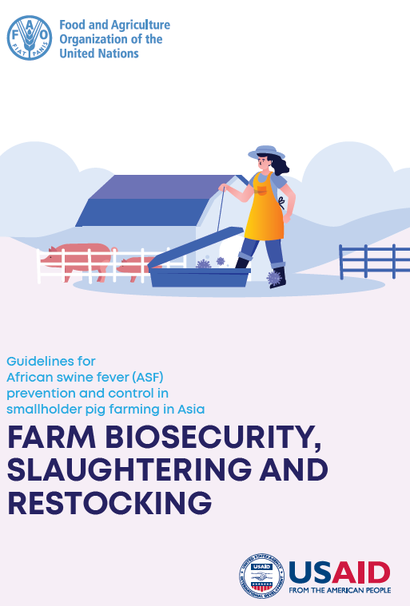
Improvement of biosecurity
Expert opinion with swine veterinarian, vet assistants and government experts
30 biosecurity measures / 5-point likert scale
Effectiveness | Practicability | Sustainability
Deliveries and Supplies | Introduction of new pigs | Manure Management
Vehicle and equipment | Personal and training | Personal and training
“Designate area for loading and offloading” would not be accepted by the farmers
Bremang et al. 2022. Guidelines for African swine fever (ASF) prevention and control in smallholder pig farming in Asia: Farm biosecurity, slaughtering and restocking. Bangkok, FAO
Notes:
Quadrupple Protection procedure (Tian et al, 2021): no report of how training
Testedin 25 small farms with ASFV
Construction of “protextive walls”: three types. olid pen wall, mosquito net, and rat-proof wall. environmental disinfection, regular immunization, and feed quality. takes care of the farms’ construction, environmental disinfection, regular immunization, and feed quality (test the virus iin the feed)
“small-scale pig farms (which produce and sell pigs fewer than 10,000 per year)

Slide 13
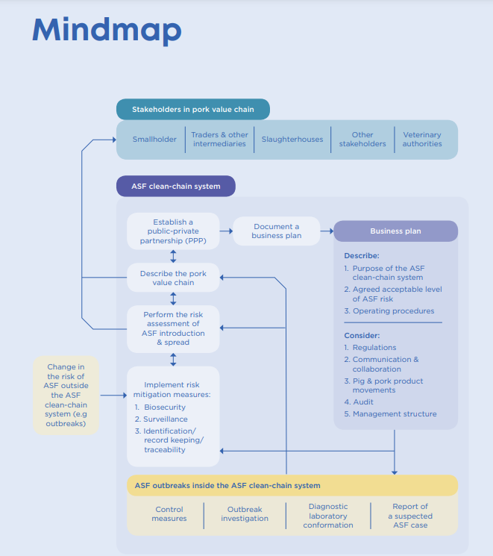
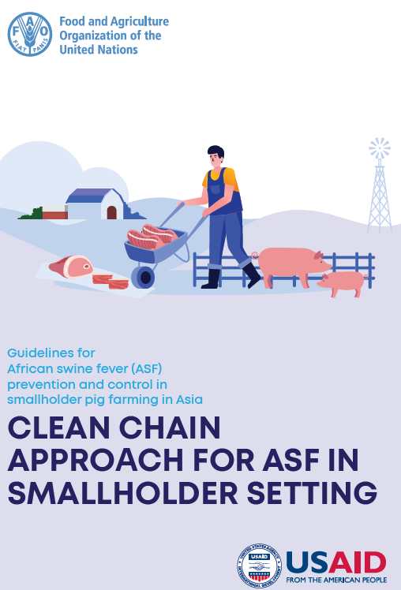
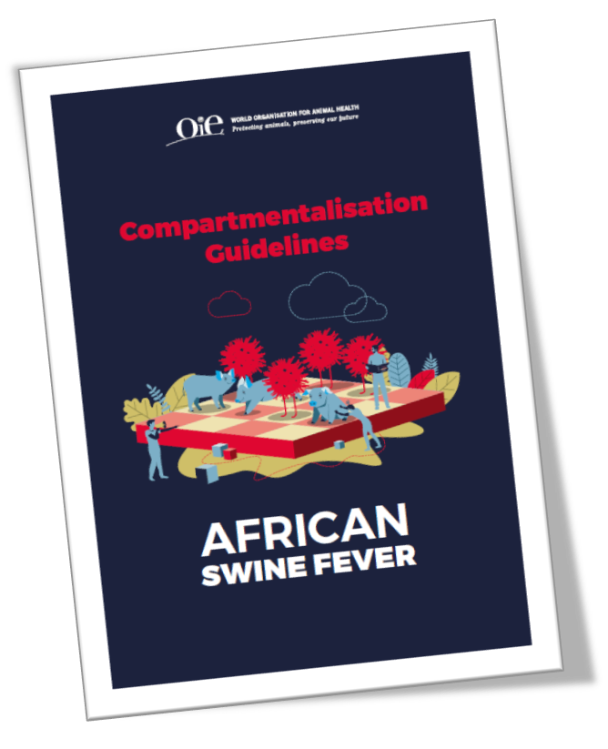
Compartmentalisation and clean-chain approach
Not applicable to smallholders
Kim et al. 2022. Guidelines for African swine fever (ASF) prevention and control in smallholder pig farming in Asia: Clean chain approach for African swine fever in smallholder settings. Bangkok, FAO. Bangkok, FAO

Slide 14







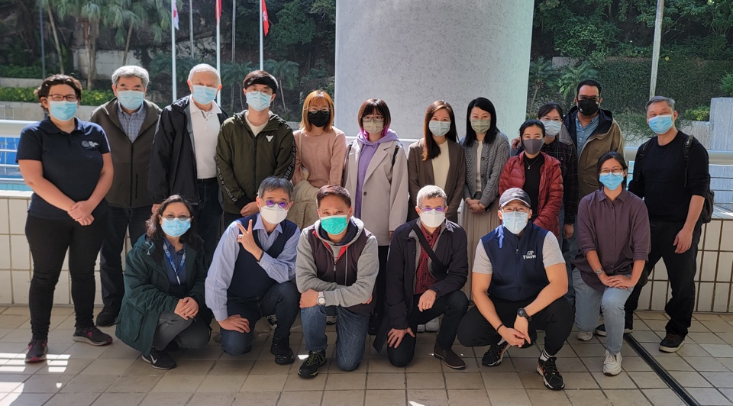



Acknowledgements
Dr. Go, Dr. Nega …
  Dr. Ho, Dr. Yu, Dr. Brackman …
Prof. Pfeiffer, Dr. Kim, Dr. Bremang, Dr. Yang, Dr, Kohnle, Dr. Nekouei, Dr. Win …
Dr. Oh, Dr. Willis, Mr. Hao, Dr. Tago …
ASF goes global
Dr. Abila, Dr. Rinzin …

